Slide 1
Up and Running with ASP.NET MVC-Core
Latest version of Microsoft’s MVC based web application development framework

Slide 2
Rob Das
IT Consultant
Web Developer – Specialize in Microsoft Technologies
Over 20 years of industry experience in IT
Clients have included government, manufacturing, insurance industry, criminal justice system

Slide 3
Overview
ASP.NET MVC Core 1.1
Building enterprise ready software
MVC design pattern
The .NET MVC framework

Slide 4
ASP.NET Core
Powerful tool set for building web based applications
“Core” is the next generation of ASP.NET
In 2015 Microsoft was going to call the it’s new web framework ASP.NET 5
In 2016 Microsoft decided that naming it ASP.NET 5 didn’t go far enough
It was a complete re-write of the entire framework
It was renamed ASP.NET Core and numbering started again from 1.0
We are at what Microsoft currently calls “ASP.NET Core 1.1”

Slide 5
What are the 2 hardest things in computer science?
cache invalidation
and naming things
and off-by-one errors ☺

Slide 6
Building enterprise ready web based applications
“web based” should need no explanation – web connected devices have become ubiquitous
“enterprise ready” means can be used by large organizations – can expect them to be secure, scalable, extensible, testable.
Scalable – expect the number of users and the amount of information to continuously increase
Extensible – expect the system to be used in new ways as business needs change – ever increasing complexity
Security – protection of computing assets from theft, damage, misuse, disruption of the service they provide.
Testable – can test and verify correct functionality.
Security is such a big subject that I have purposely omitted it from the rest of this presentation – at the very least it deserves its own presentation.

Slide 7
MVC Theoretical Model
MVC refers to the Model-View-Controller design pattern
Discussed in the introduction to the Gang of Four book, Design Patterns, Elements of Reusable Object-Oriented Software, 1995
“The Model is the application object, the View is its screen presentation, and the Controller defines the way the user interface reacts to user input.”
Used more than a decade earlier in the Smalltalk 80 programming language

Slide 8
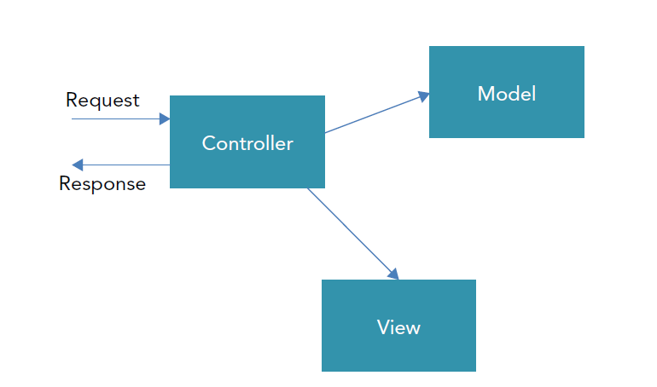
MVC – request response life cycle

Slide 9
Some important benefits of MVC
architecture that lends itself to automated testing
separation of concerns
easier to manage and maintain application over its lifetime

Slide 10
Best Practices
Separation of concerns – separates computer programs into distinct sections that address separate concerns. Example: a well written web page separates structure, style, and behavior into HTML, CSS, JavaScript (EcmaScript).
Modular program design – well designed modular systems are loosely coupled and highly cohesive. Coupling refers to the interconnections between modules; cohesion refers to the programming within a module.
SOLID principles of object oriented programming and design allow you to create a system that is easy to maintain and extend over time.
convention over configuration – design paradigm that decreases the number of decisions a developer makes without losing flexibility.
other noteworthy best practices: DRY, YAGNI, use the right tool for the job.

Slide 11
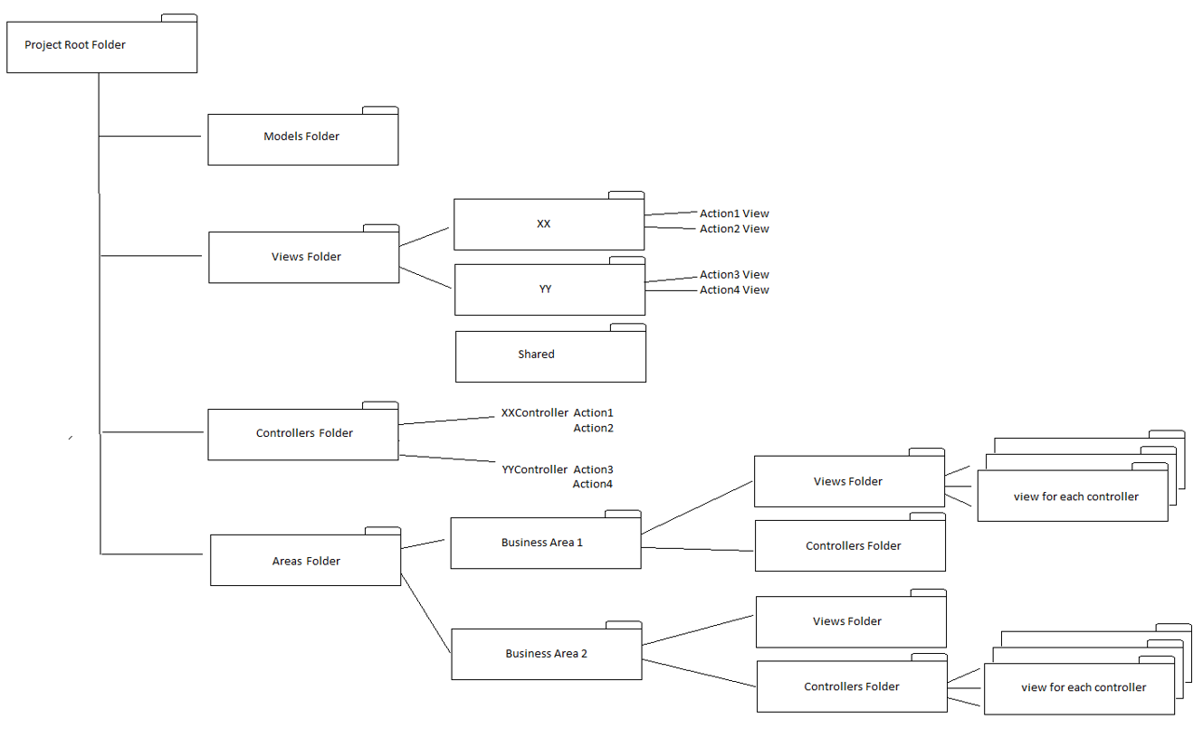
Convention over Configuration

Slide 12
SOLID Principles
S – single responsibility; a class should have one responsibility
O – open/closed; open for extension, closed for modification
L – Liskov substitution; objects can be replaced by subtypes
I – interface segregation; many small ones are better than one big one
D – dependency inversion; depend on abstractions not concretions

Slide 13
MVC Core framework – components
Models, Views, Controllers
Routing engine that maps incoming requests to controllers
Controllers contain actions that are represented by methods
Overloading is used to map multiple methods to actions based on different HTTP verbs. For example suppose you have an action called Edit. You would typically have different Edit methods for a GET request and a POST request.
Controller actions are associated with views.
A mechanism called Binding is used to connect models to actions and views.

Slide 14
Key files/folders in MVC Core
Startup.cs – runs code at application start – typically has constructor, Configure adds services to the HTTP request pipeline, and ConfigureServices initializes dependency injection.
_Viewstart.cshtml – provides a way to connect views to layout files.
_Layout.cshtml – provides common or shared user interface to multiple views. Layouts can be nested. Similar to Master pages in the old webforms framework.
wwwroot – a folder for static content such as image files, scripts, and stylesheets. Favicon.ico goes here.
bower.json – package manager for client side packages

Slide 15
Web API
REST – architectural style for web services that are lightweight, maintainable and scalable
discoverable and self documenting
API defined in terms of resources and collections of resources
endpoints are based on resource names
actions are not named, instead they are implied by HTTP verbs
stateless – each request/response roundtrip should be self contained
KIS – keep it simple
SOA – style of software design that provides a collection of services that function independently and are available through a communication protocol over a network.

Slide 16
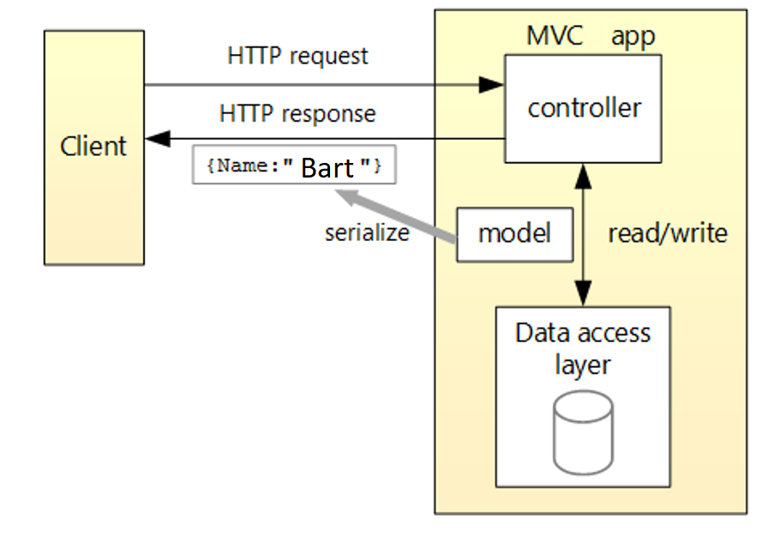
Web API example

Slide 17
Lets build something!
Open Visual Studio 2017 and create a new project
Choose ASP.NET Core Web Application (.NET Core)
From ASP.NET Core 1.1 Templates choose Web Application
This creates a complete working example application
For a production system it’s not a good idea to start with this example application.
Another way to go is to start with the Empty template and only add what you need.

Slide 18
Start with an Empty template…
Open Visual Studio 2017 and create a new project
Choose ASP.NET Core Web Application (.NET Core)
From ASP.NET Core 1.1 Templates choose Empty
Starts you with a new project that is bare bones.
Add only what you need.

Slide 19
MvcDemo Application
Starting with an empty template.
I added all the MVC stuff.
I added client side packages Bootstrap and Jquery unobtrusive validation using the Bower package manager.
I added a repository layer.
And I added RESTful API to separate domain login.

Slide 20
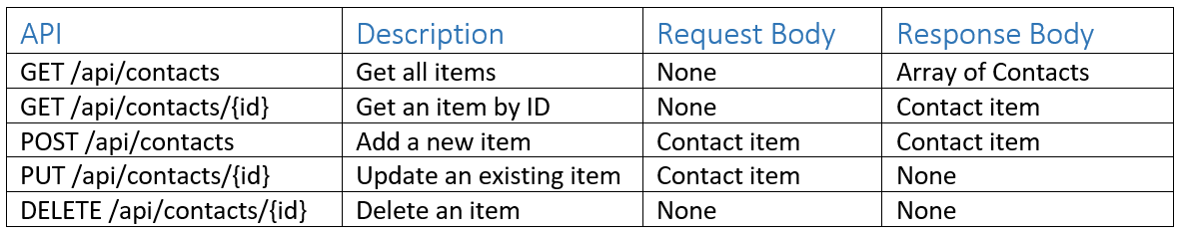
Contact RESTful API

Slide 21
References
Professional C# 6 and .NET Core 1.0, Christian Nagel
Design Patterns, Gang of Four, ISBN 0-201-63361-2
Tutorial: https://docs.microsoft.com/en-us/aspnet/core/data/ef-mvc/intro
Important steps for hosting ASP.NET Core on IIS https://docs.microsoft.com/en-us/aspnet/core/publishing/iis

Slide 22
The End – Any questions?

